Slide 1
TEACHER CUE
CFU
HINT
Scaffolding for students
MAKE THE CONNECTION
Allow students to make the connection

Slide 2
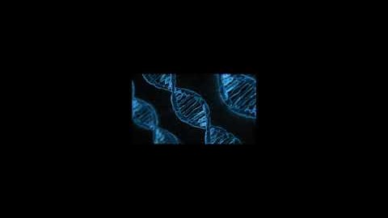

Slide 3
I can describe inheritance through the use of punnet squares
Define the terms inheritance, dominant and recessive.
Explain how Mendel used peas to demonstrate inheritance.
Explain the difference between genes and alleles.
Use correct notation to show dominant and recessive traits.

Slide 4
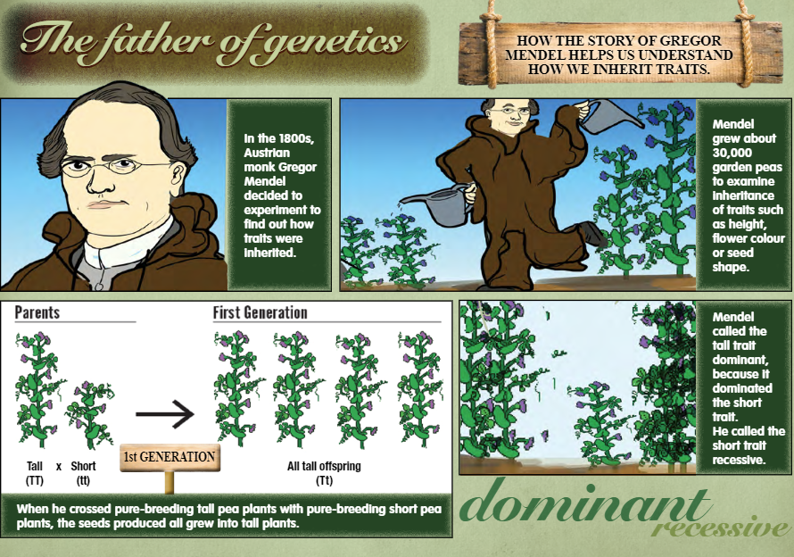

Slide 5
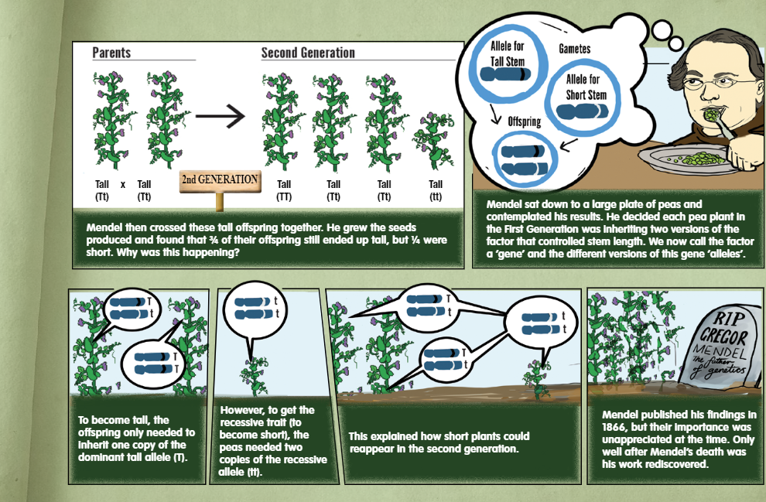

Slide 6
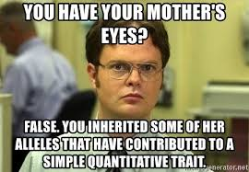
I can describe how mitosis relates to DNA
Add to Word Wall
Gene: A section of DNA that contains the instructions to determine traits.
Trait: The physical expression of a gene that varies among individuals. Examples: hair colour, hair texture, eye colour, height
Allele: The different forms of a trait.
Examples: brown or blonde, curly or straight, tall or short

Slide 7
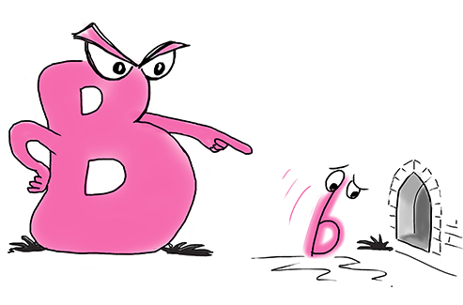
I can describe how mitosis relates to DNA
Dominant: The form of a trait that is shown if it is present
It is symbolised with a capital letter.
Example: Tall = T
Recessive: The form of a trait that is only shown if a dominant allele is absent. If dominant is present, recessive is hidden.
Example: Short = t

Slide 8
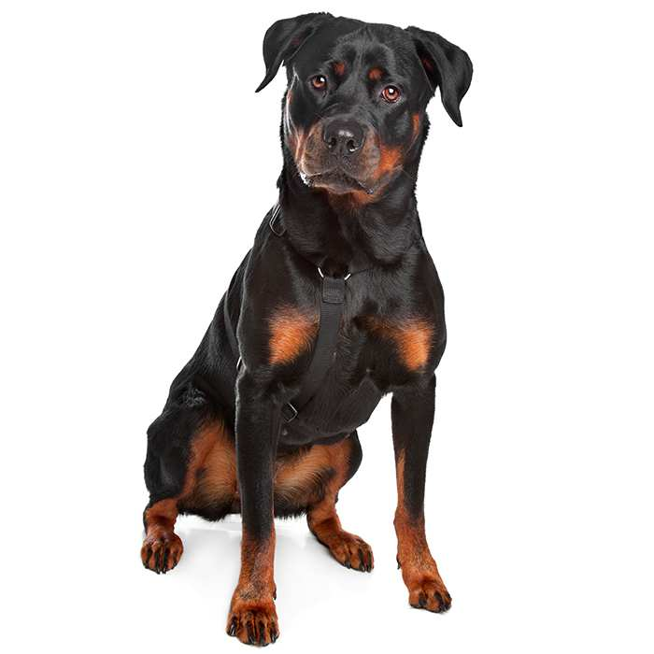
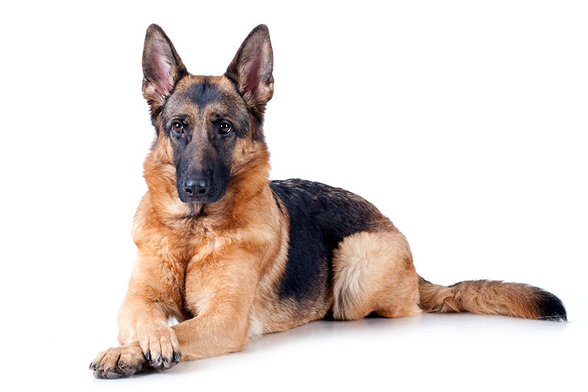
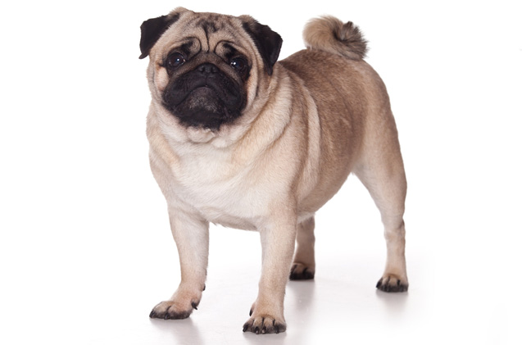
I can describe how mitosis relates to DNA
Add to Word Wall
Homozygous:
Contains two alleles in the same form.
Pure breeding, true breeding.
Can be dominant or recessive
TT and tt AA and aa
BB and bb
What Are the Pros of Owning a Purebred Dog? Predictable Physical Traits Predictable Behavior and Temperament
Approved to Compete in Dog Shows What Are the Cons of Owning a Purebred Dog? Health Problems Expense

Slide 9
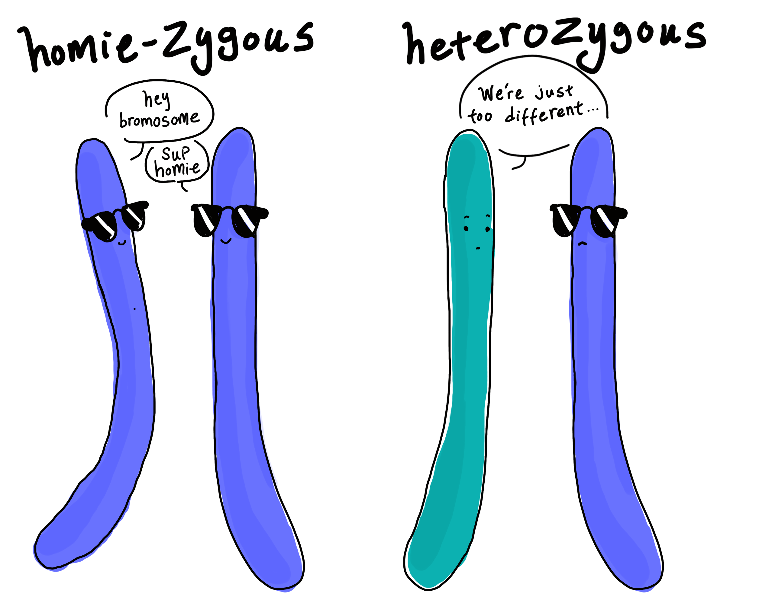
I can describe how mitosis relates to DNA
Add to Word Wall
Heterozygous:
Contains two alleles in different forms.
Hybrid, carrier
Contains one dominant and one recessive allele
Tt Bb
Aa Dd

Slide 10
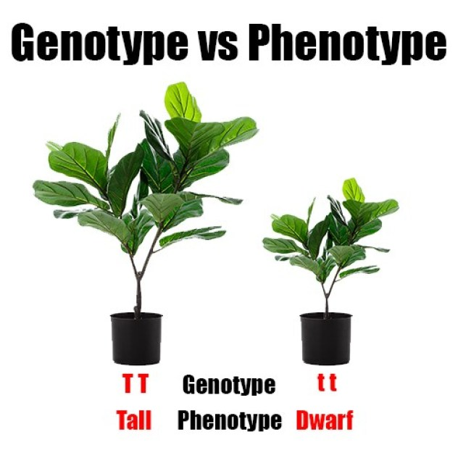
I can describe how mitosis relates to DNA
Add to Word Wall
Genotype:
- The genetic makeup of a trait. (The code)
- TT, Tt, tt
Phenotype:
- Physical appearance (what you see!)
- Tall or short, blue eyes or brown eyes, green or yellow

Slide 11
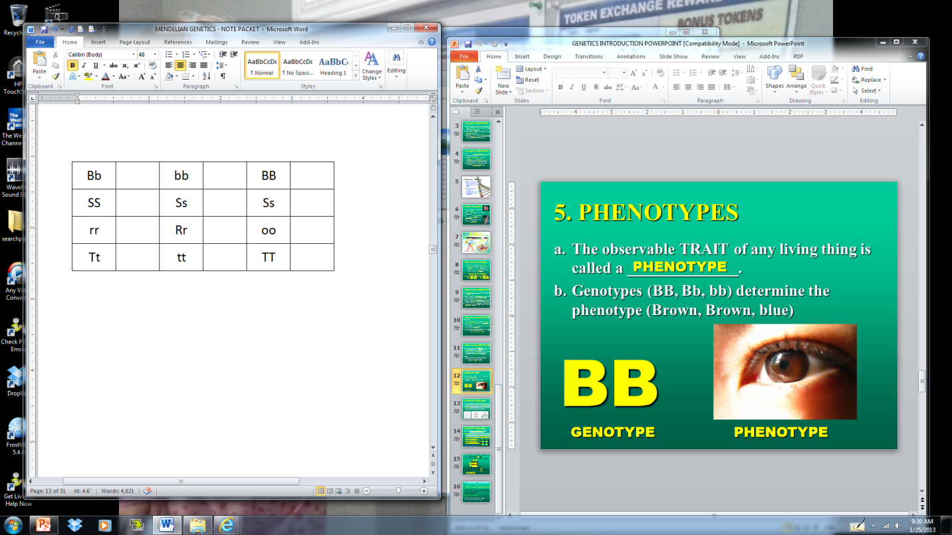
CHECK FOR UNDERSTANDING
He
Ho
Ho
For each genotype,
Indicate whether the following alleles are Heterozygous (He) or Homozygous (Ho)
Ho
He
He
Ho
He
Ho
He
Ho
Ho

Slide 12
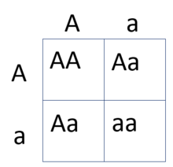
One way to visualise how genes combine is through the use of Punnet Squares. By using Punnett squares you can work out the probabilities that children of the parents will have specific phenotypes and genotypes.
Remember that dominant alleles are symbolised with capital letters, and recessive alleles are symbolised with lowercase letters.
Question: How have they got the results in the table below?

Slide 13
We Do
In rabbits, black fur is dominant to white fur. If you cross a BB male with a Bb female, what are the possible genotypes and phenotypes of the offspring? What is the percent chance for each type?
1. Place the parents alongside the top and left of the table
2. ‘Multiply’ the letters to complete the table
3. Genotypes = codes
4. Phenotypes = physical appearance

Slide 14
You Do
In mysterious creatures known as Mr Forte’s, cauliflower ear is dominant to normal ear. If you cross an EE Forte with an ee Forte, what are the possible genotypes and phenotypes of the offspring? What is the percent chance for each type?
1. Place the parents alongside the top and left of the table
2. ‘Multiply’ the letters to complete the table
3. Genotypes = codes
4. Phenotypes = physical appearance

Slide 15
I can describe inheritance through the use of punnet squares
Define the terms inheritance, dominant and recessive.
Explain how Mendel used peas to demonstrate inheritance.
Explain the difference between genes and alleles.
Use correct notation to show dominant and recessive traits.

